Slide 1

Data Presentation for Everyone
Allison Sliter
Sr Data Scientist
@allisons (Twitter and Github)

Slide 2
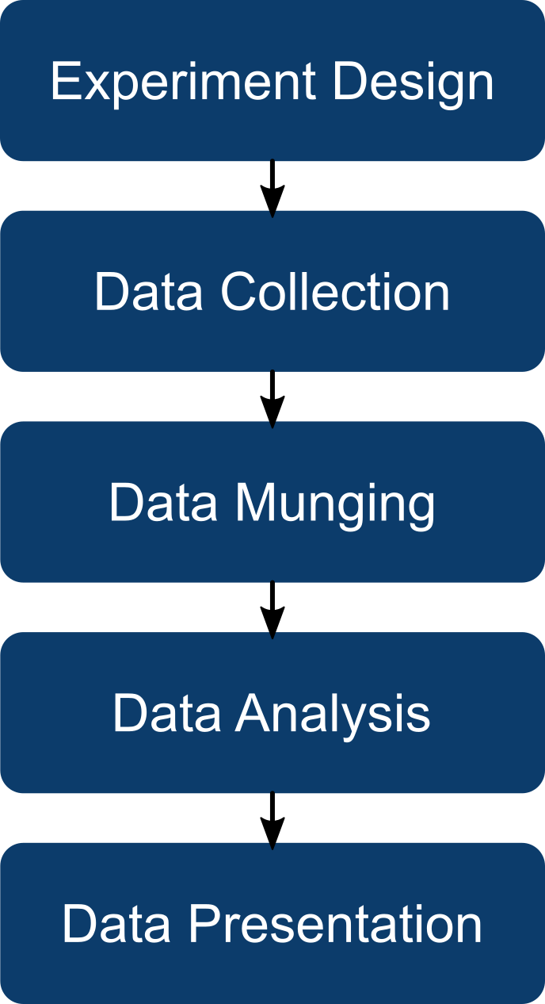
What is Data Presentation?
Last step in the data analytics process.
Includes but is not restricted to data visualization.
The thing that makes your work have an impact.

Slide 3
Overview
Center your Audience
Structure Your Presentation For Maximum Impact
Do the Work For Them

Slide 4
Center Your Audience

Slide 5
Question 1 (Raise your hand if this applies to you)
“I regularly present the results of data analysis that I performed (alone or as part of a team) to an audience”

Slide 6
Question 2 (Raise your hand if this applies to you)
“I have a strong and clear view about when it’s appropriate to use a Wilcoxon Signed Rank Test and when I should use a 2-sample independent T-test”

Slide 7
Question 3 (Raise your hand if this applies to you)
“I’d rather you skip the “why”s behind good effective data presentation and focus on the tips and tricks”

Slide 8

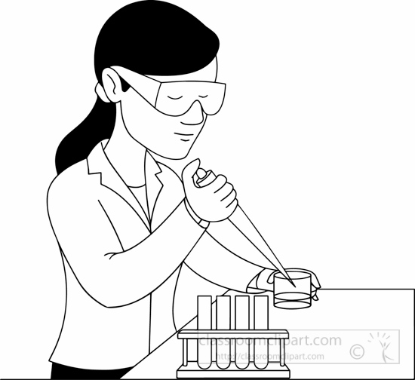


Who Is Your Audience
Why are they interested in what you’re doing?
How does it relate to their job?
What’s their (formal and informal) education?
My audiences include:
Managers
Subject Matter Experts
Software Developers
Stakeholders from Sales and Marketing

Slide 9
What You Need From Your Audience

Slide 10
Start With Guiding Questions:
What do we already know?
What do you want to know?
What resources do I have access to?
Why do we need to know this?
What do you think the answer is?
These can’t be answered by an analyst! They have to be answered by whoever is requesting the data. And you will not know what to present to them if you don’t have these questions answered.

Slide 11
Answers to your guiding questions -> A Well Formed Question
A question is well formed when it…
Is actually a single question.
Can be answered
Is clear when the answer has been found (and if it hasn’t!)
Surfaces all premises and semantics so they can be agreed upon by stakeholders and analyst.
Allows you to fill in a 2x2 table of known and unknowns.
 | Known | Unknown
Known | Things we know we know | Things we know we don’t know
Unknown | Things we don’t know we know | Things we don’t know we don’t know.

Slide 12
Speak to Your Audience

Slide 13
Use Plain Language instead of Jargon
Jargon | Plain Language
Group-specific, highly specialized and precise. | Chooses vocabulary (and word senses) that should be understandable to any speaker of Professional English.
Efficient when everyone speaks the jargon, but… | Sentences may be shorter and thus more numerous, but…
Often overloads vernacular terms leading to confusion. | Utilizes clear distinctions

Slide 14
Examples of Plain Language
Instead of… | Try…
Statistically Significant | “If we did this experiment again, it would be unlikely to come up with a different result”
Null Result | “We haven’t gotten enough data to answer your question. More data may help.”
Confidence Interval | “We’re pretty sure the true answer is between this and that.”
p-value | Maybe skip talking about p-values at all?
More guidance here: https://www.plainlanguage.gov/guidelines

Slide 15
Structure Your Presentation To Make An Impact

Slide 16
The Hero’s Journey narrative structure, or What Not To Do.

Slide 17
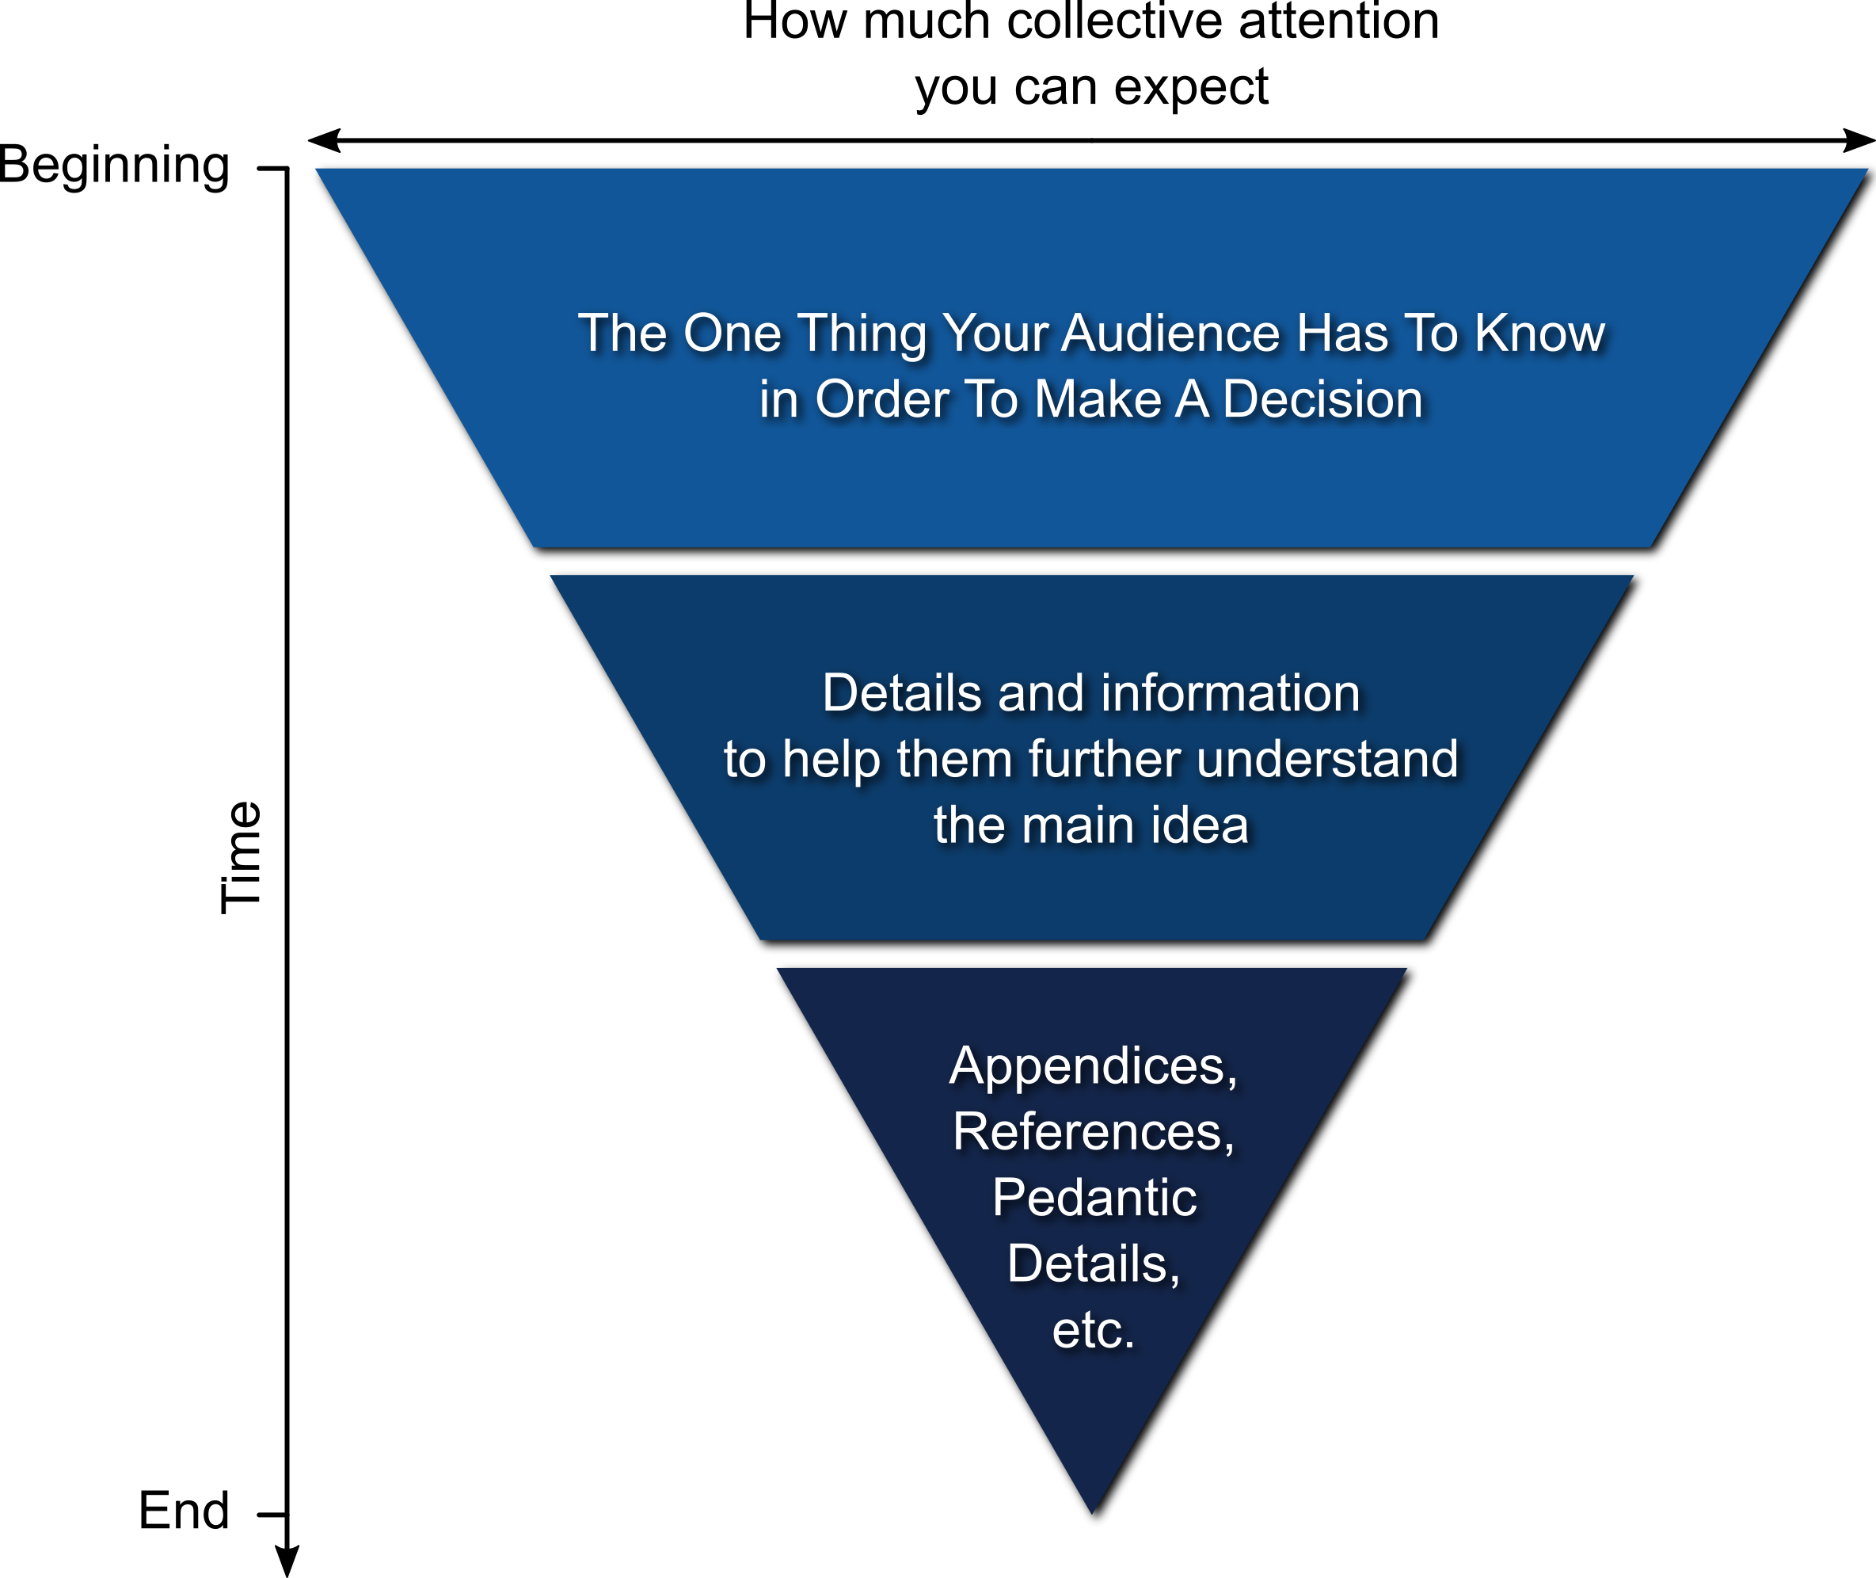
Inverted Pyramid or the Right Way to structure a presentation

Slide 18
Do the Work For Your Audience

Slide 19
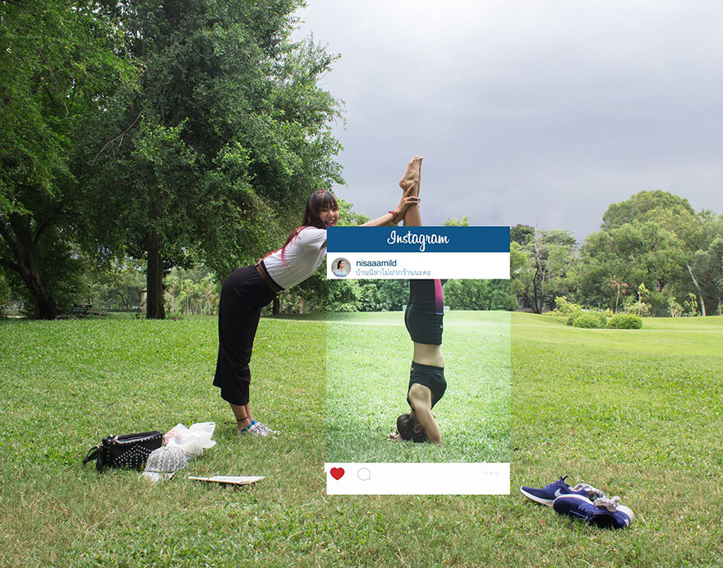
Your Whole Data Project
Your presentation
h/t BoredPanda

Slide 20
Know What You’re Trying to say (and not say) ahead of time.
Statistical deliberations are kept off stage
Create supporting materials for reference, but keep a lot of details out of the presentation
Leave out any figures that you created as part of your exploration but doesn’t support the story you’re telling.
“I take every word out into the alley and I ask what it’s doing in my poem, if the answer is nothing, I cut ‘em.” – Nate Marshall

Slide 21
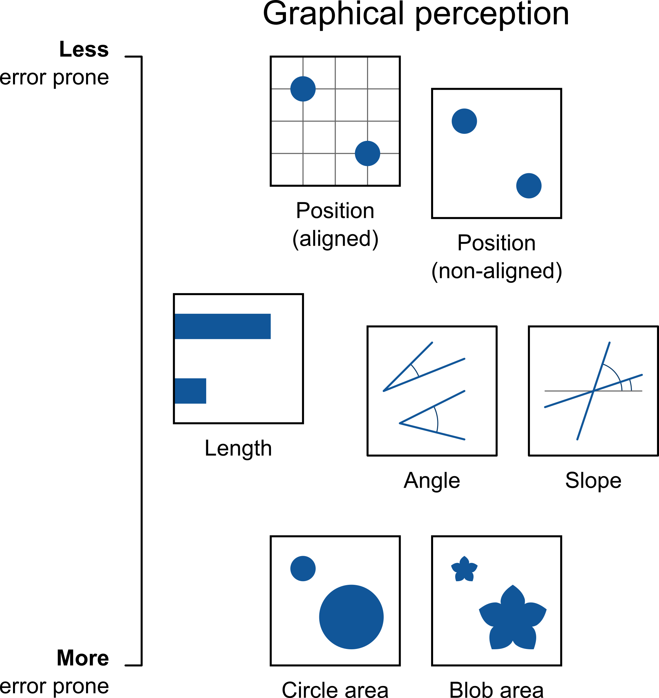
Choose graphics and aesthetics that Support Intuitive Understanding
Cleveland, W., & McGill, R. (1984).

Slide 22
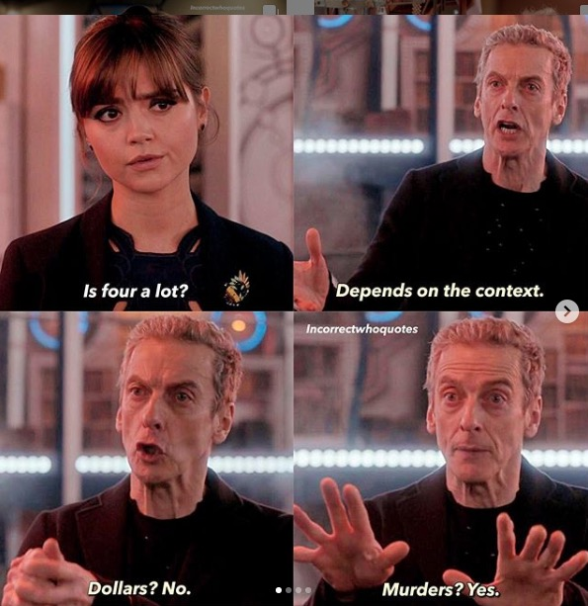
Use visual cues to help your audience home in on what’s relevant.
Show baselines (norm your data)!
Scale to the interesting bit.
Set up parallelism
Visual confidence intervals
Keep labels close to what they’re labeling.
h/t @ChelseaParlett

Slide 23
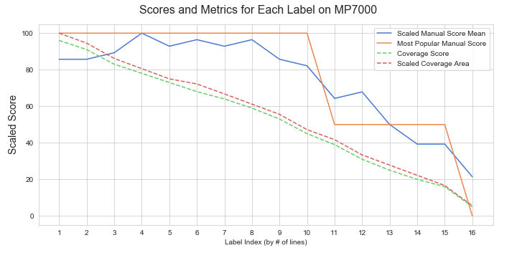
Scaled and Normed Example

Slide 24
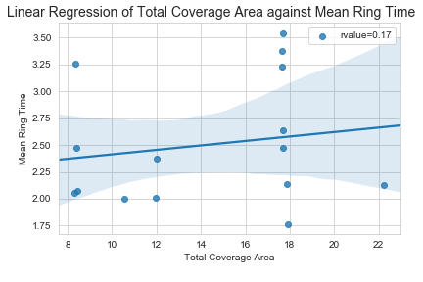
Visualized Confidence Intervals

Slide 25
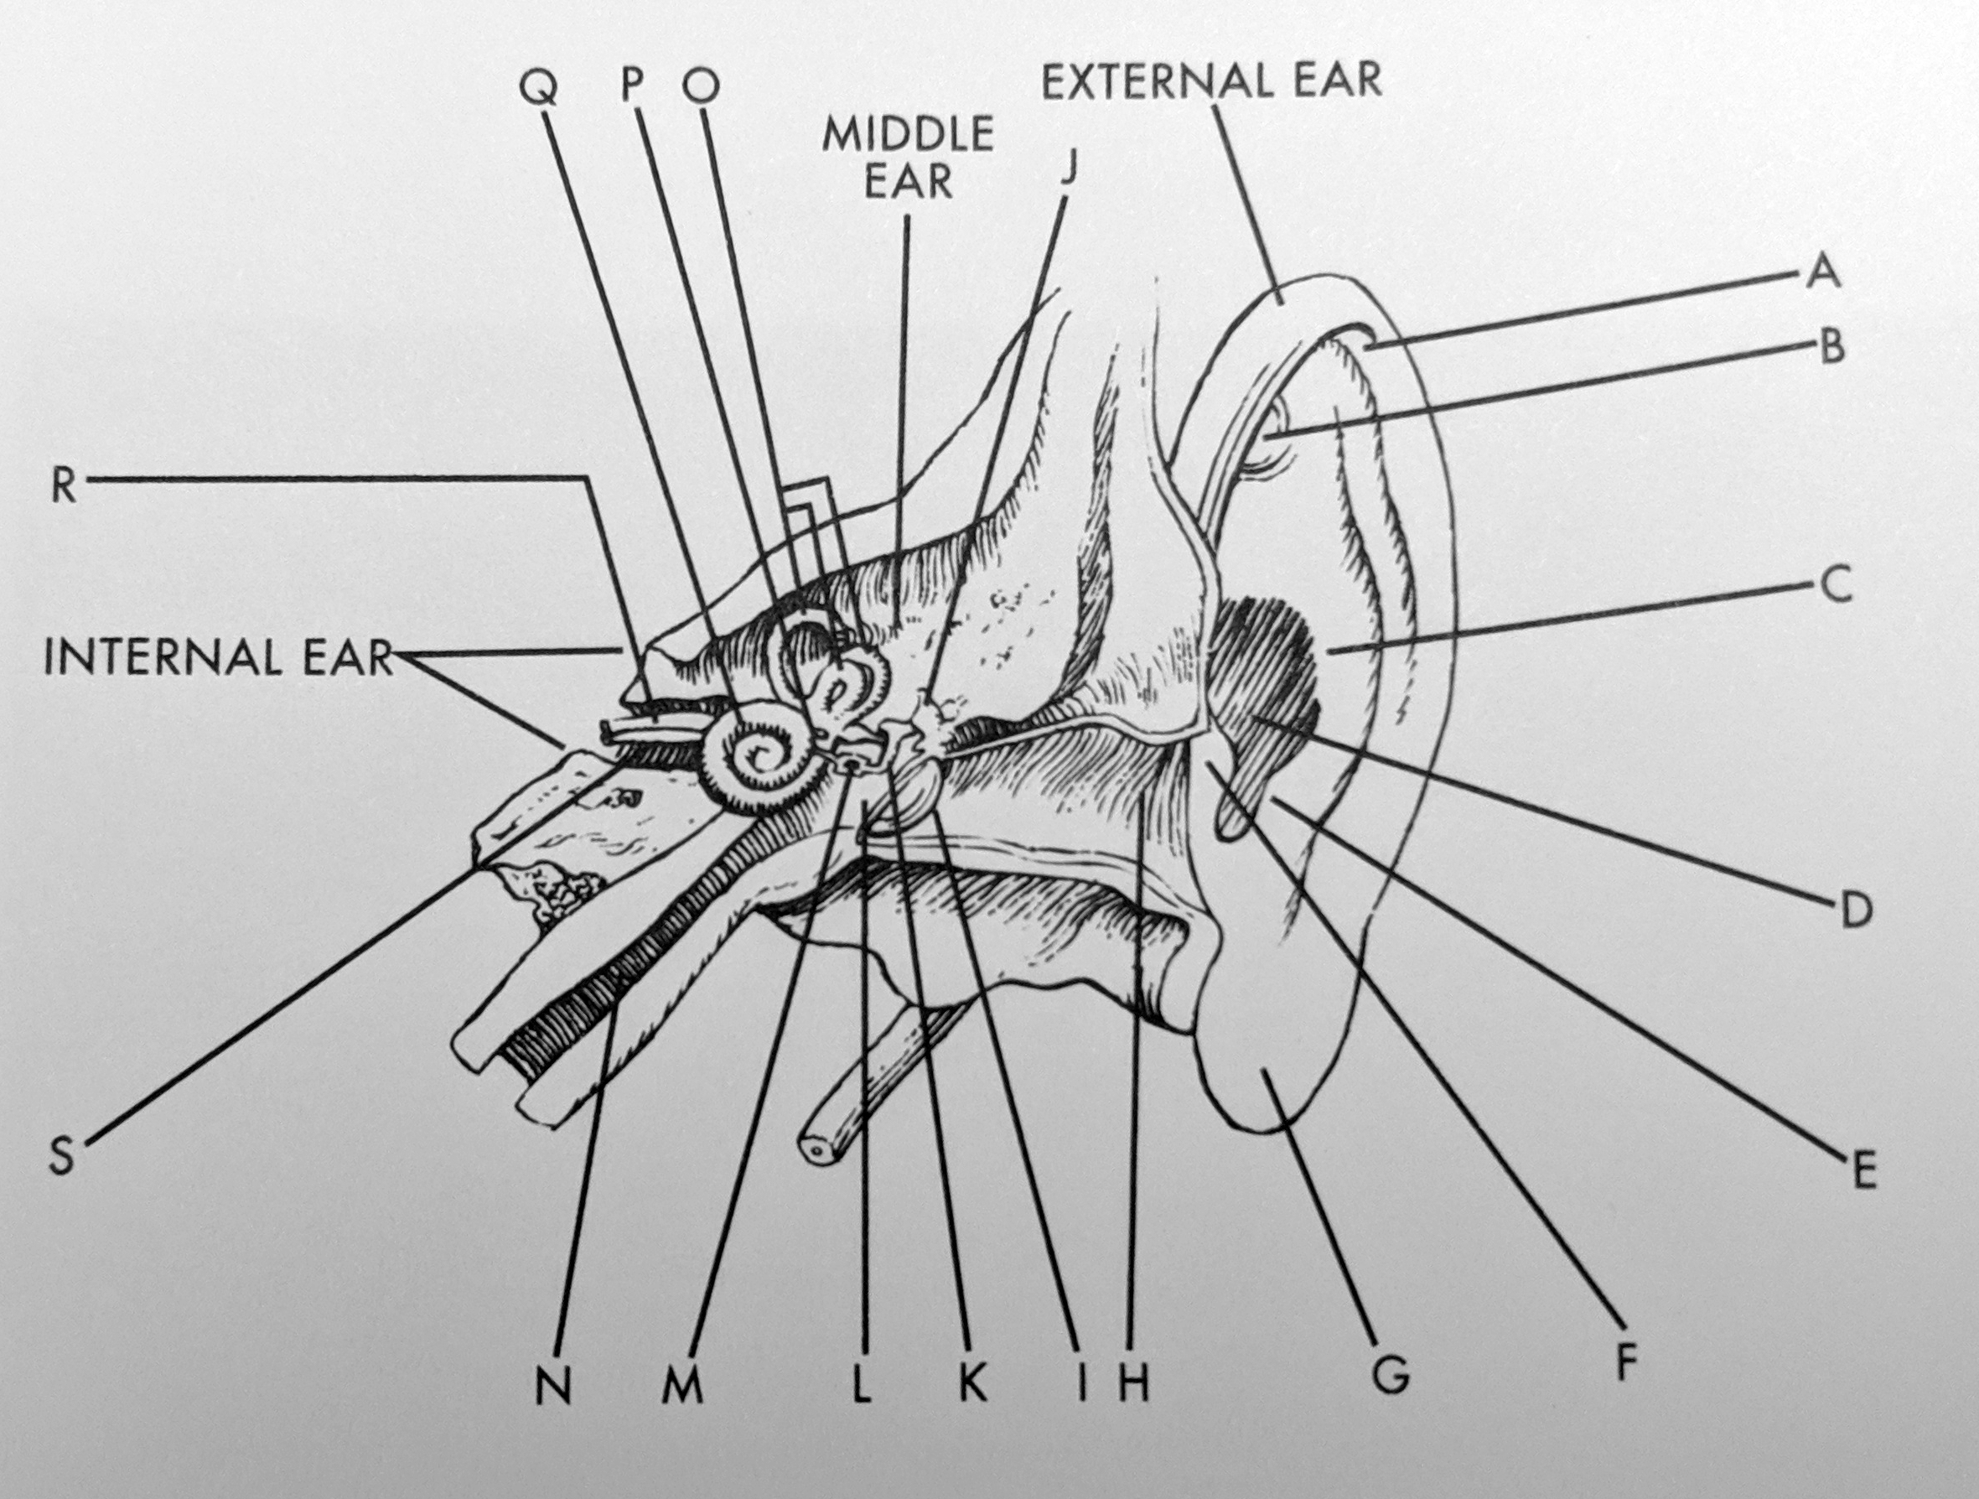
Keep All Annotations Close To What They’re Annotating
h/t Tufte, Edward, Visual Explanations 1997

Slide 26
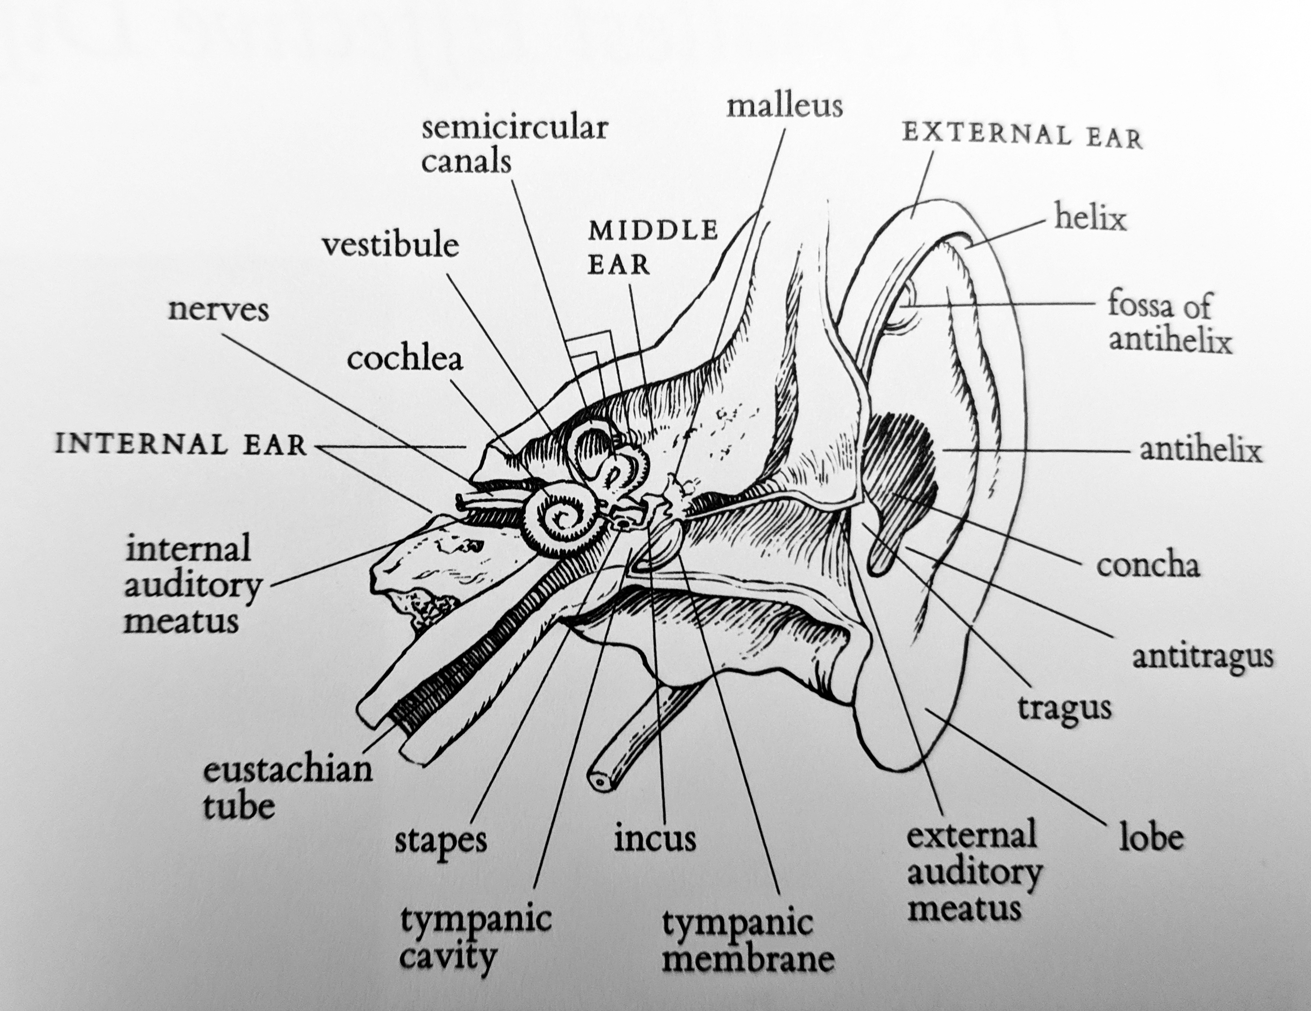
Keep All Annotations Close To What They’re Annotating
h/t Tufte, Edward, Visual Explanations 1997

Slide 27
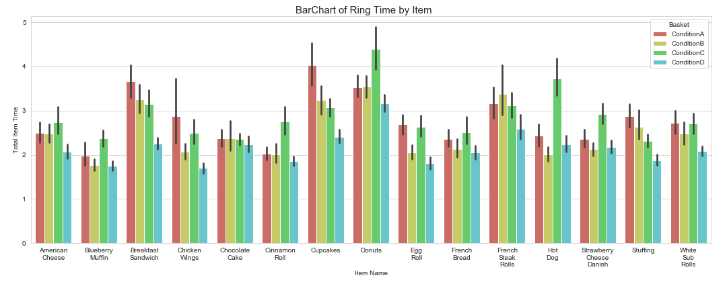
Choosing the Right Plot

Slide 28
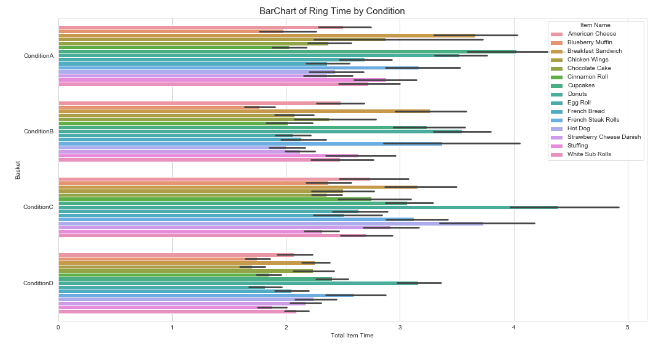
Choosing the Right Plot

Slide 29
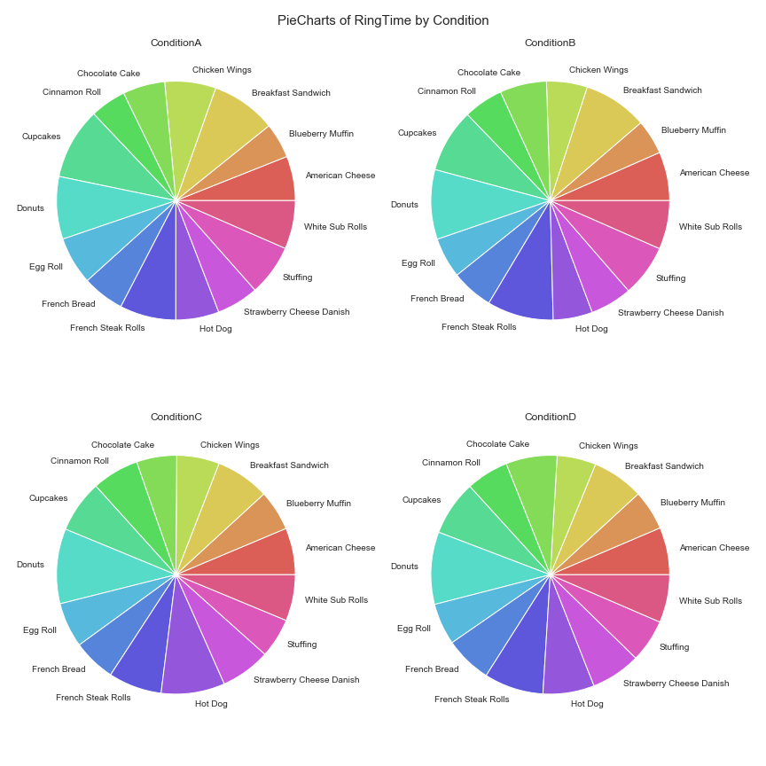
Choosing the Right Plot

Slide 30
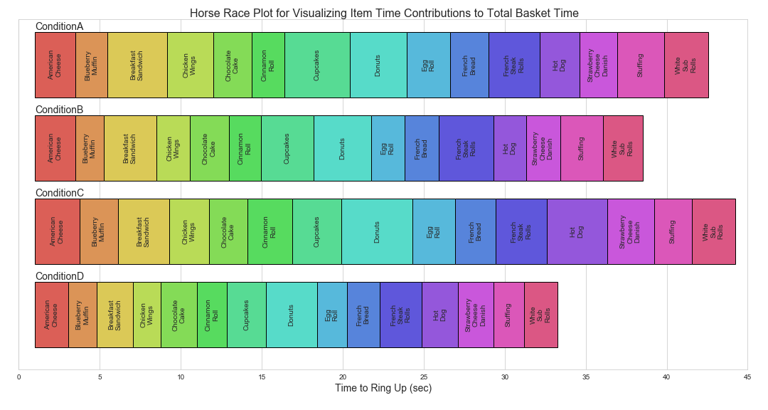
Choosing the Right Plot

Slide 31
End on a Clear Note

Slide 32
TL;DR conclusion
The most important thing comes first
When in doubt, say less
Design your presentations for human brains

Slide 33
Further Reading
Cleveland, W. S., & McGill, R. (1984). Graphical perception: Theory, experimentation, and application to the development of graphical methods. Journal of the American statistical association, 79(387), 531-554.
Kahneman, D. (2011). Thinking, fast and slow. New York: Farrar, Straus and Giroux.
Federal plain language guidelines https://www.plainlanguage.gov/guidelines/
Tufte, Edward R., 1942-. (1997). Visual Explanations. Cheshire, Conn. :Graphics Press,
Yau, Nathan. (2013) Data Points: Visualization That Means Something

